Slide 1
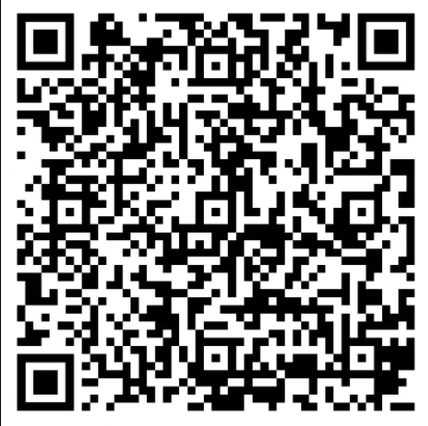
Our 4th Grade Classroom News
The Week of 10/12/20
Mrs. Carson: lcarson@Paulding.k12.ga.us Mrs. King: stking@Paulding.k12.ga.us Mrs. Walton: rwalton@paulding.k12.ga.us
Mrs. Chapman jtallman@Paulding.k12.ga.us
Mrs. Mittelman: b mittelman@paulding.k12.ga.us Mrs. Yergin: ayergin@paulding.k12.ga.us
Reading/Writing
RI1:Refer to details and examples in a text when explaining what the text says explicitly and when drawing inferences from the text.
RI3:Explain events, procedures, ideas, or concepts in a historical, scientific, or technical text, including what happened and why, based on specific information in the text
RI5:Describe the overall structure of events, ideas, concepts, or information in a text or part of a text.
RI7: Interpret information presented visually, orally, or quantitatively and explain how the information contributes to an understanding of the text in which it appear
RI8:Explain how an author uses reasons and evidence to support particular points in a text
Narrative Writing
W3: Write narratives to develop real or imagined experiences or events using effective technique, descriptive details, and clear event sequences.
Reminders
October
12th: Fitness Day 8:30-10:30
Donation link:
https://paulding.revtrak.net/
Fitness Video:
https://youtu.be/Wi0lCJHAeys
12th-16th: Conference Week: students released at 12:30
16th : Cape Day – have your child wear their favorite cape.
Now-25th : sign up for virtual learning – if you want your child to do virtual for second semester.
Due to Covid guidelines, no cupcakes are allowed for birthday celebrations. Our amazing Cafe’ staff is now selling treats for birthdays. Scan QR code to order treats
Math and Science
OA5- Generate a # or shape pattern given a rule. ID features of the pattern, explain why the pattern will continue.
Science
E2. Obtain, evaluate, and communicate information to model the effects of the position and motion of the Earth and the moon in relation to the sun as observed from the Earth
Specials Rotations
 | Mon | Tues | Wed | Thu | Fri | Mon
Carson | No Specials | Fitness | Week |  |  | Music E
Chapman | No Specials | Fitness | Week |  |  | Music J
King | No Specials | Fitness | Week |  |  | Media
Walton | No Specials | Fitness | Week |  |  | PE
At-Home Practice
Notes:
https://paulding.revtrak.net/.https://youtu.be/Wi0lCJHAeys

